Slide 1
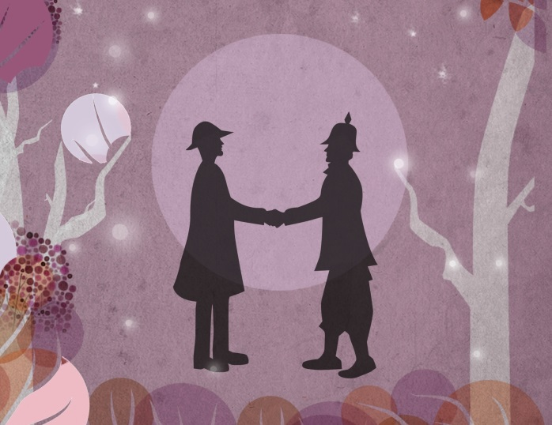
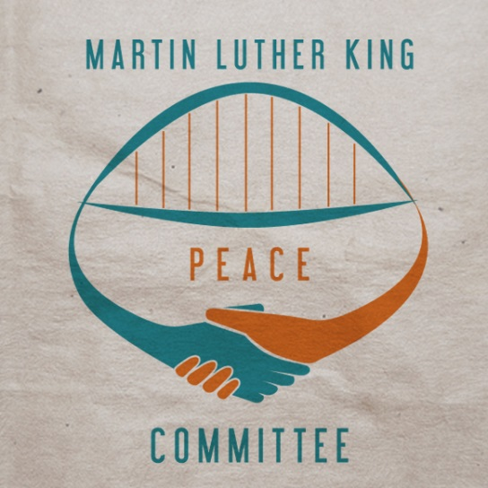
Christmas Truces Art Projects
The Northumbria and Newcastle Universities Martin Luther King Peace Committee
Notes:
This slideshow is designed to be used in conjunction with the ‘Teaching the 1914 Christmas Truces Resources Pack’ for schoolteachers, available at www.mlkpc.org It was created by Nicola Bishop for the Peace Committee
Please see the Resources Pack for the lesson plans that it accompanies.
This work is licensed under a Creative Commons Attribution-NonCommercial-ShareAlike 4.0 International License. Feel free to copy and redistribute this work, and also to remix, tweak, transform and build upon it for non-commercial uses, giving appropriate credit to the original. For details see www.creativecommons.org

Slide 2
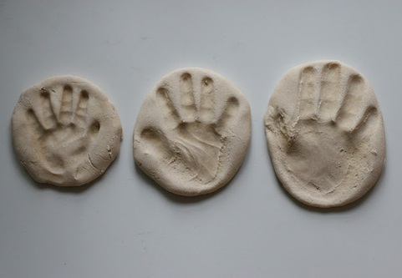
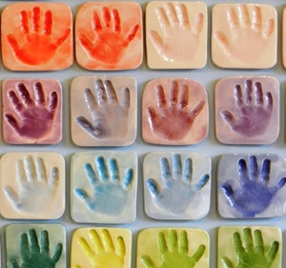
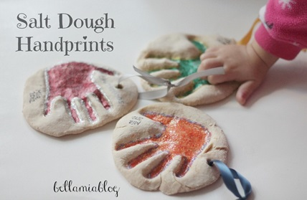
Project 1: The handshake (KS2)
These can be presented as a tile on their own or with:
An object in the hand representing the presents given
A word related to the Christmas truces

Slide 3
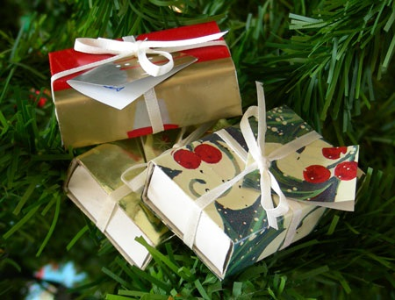
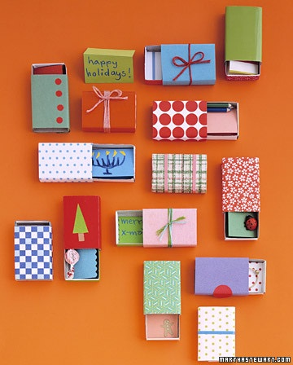
Project 2: The Christmas gift (KS2)
The Christmas Truces were marked by the exchange of gifts and souvenirs between soldiers who were meant to be fighting
Task 1: Decorate a large matchbox as a ‘Christmas present’

Slide 4
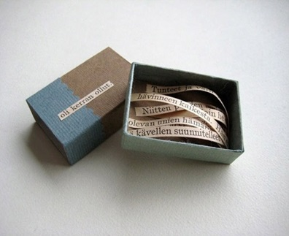
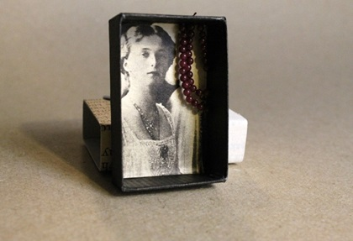
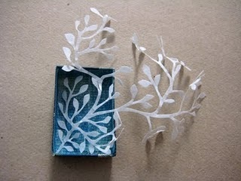
Project 2: Continued
Matchbox 'presents' could contain:
Objects representing the presents given
Photographs representing the photos of family members shared
A letter/ poem written from a soldier's point of view
Paper sculptures of images symbolising peace, unity between sides etc

Slide 5
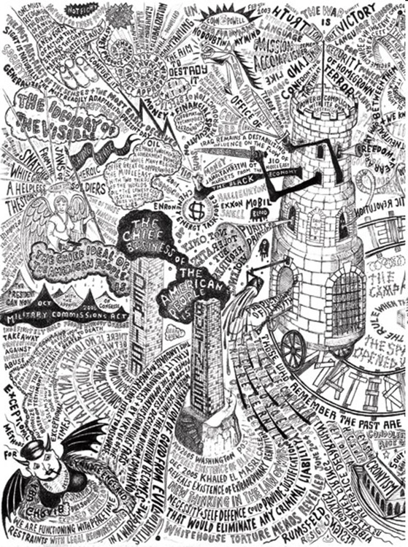
Project 3: Dominic McGill / Truce words (KS3/4)

Slide 6
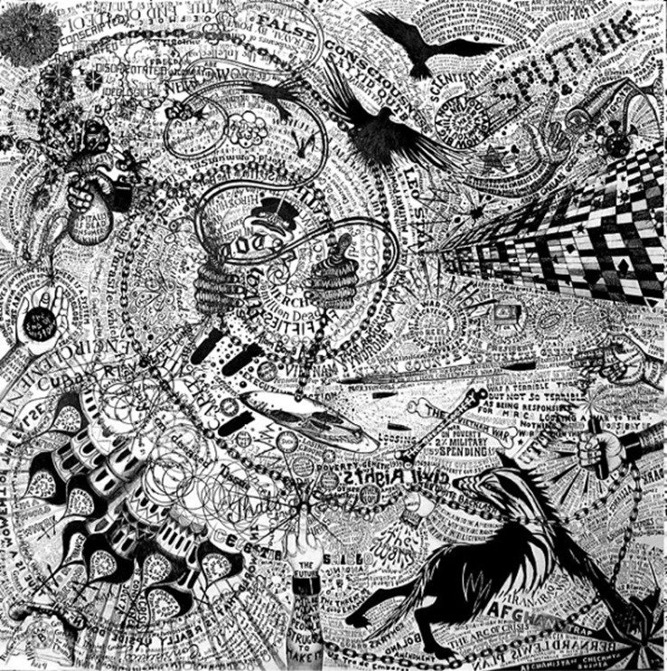
Project 3: Continued

Slide 7
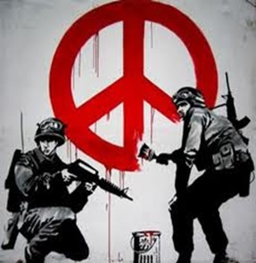
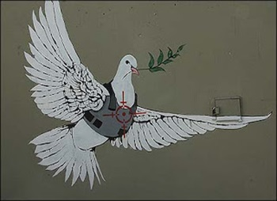
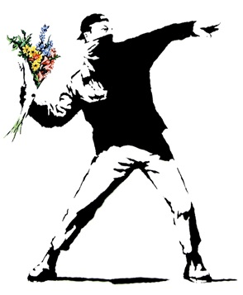
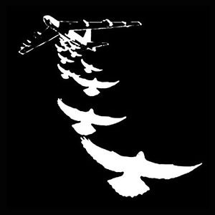
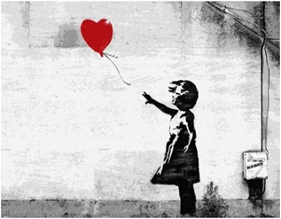
Project 3: Truce street graffiti (KS2/3)

Slide 8
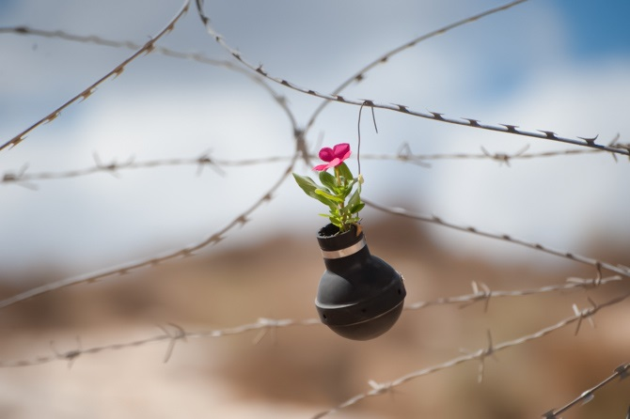
Project 4: Barbed wire and hope (KS3/4)

Slide 9
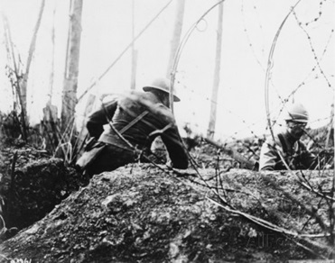
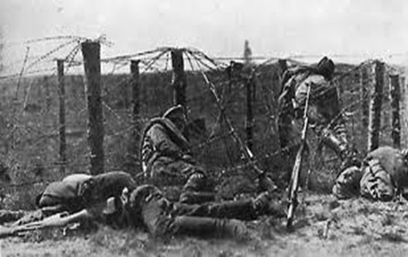
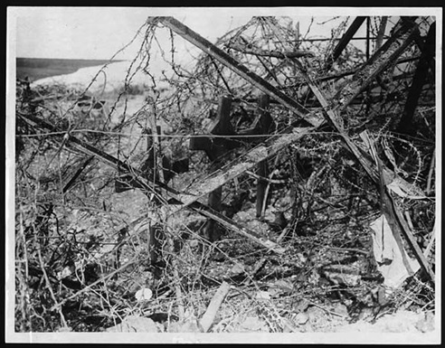
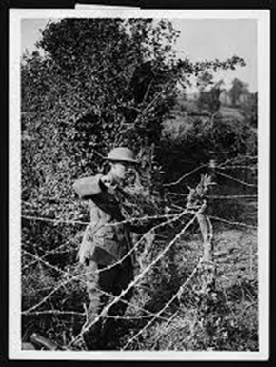
Project 4: Continued

Slide 10
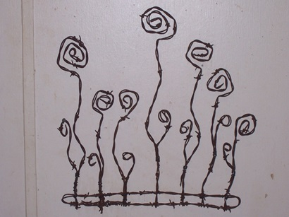
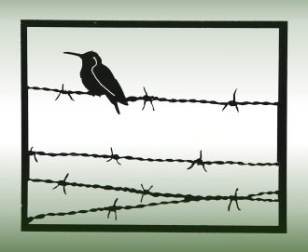
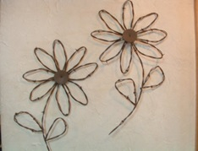
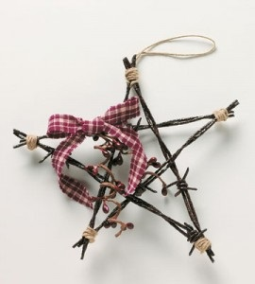
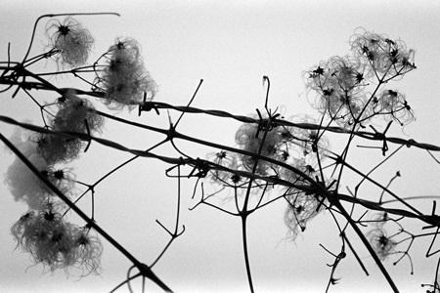
Project 4: Continued
Create images of hope out of wire/ barbed wire
For KS4, can be developed into a photogram or print

Slide 11
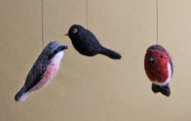
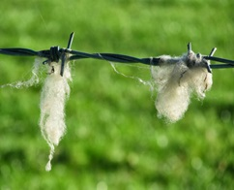
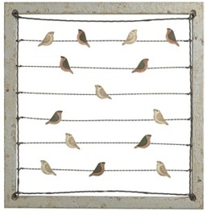
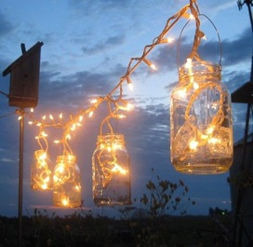
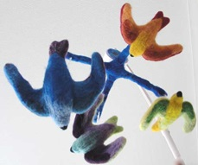
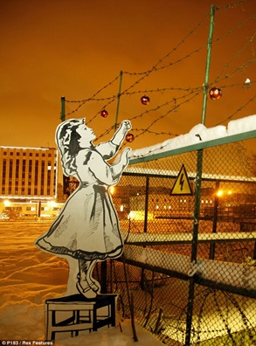
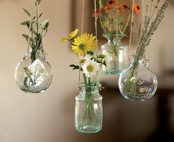
Project 4: Continued
OUTCOME:
Individual pieces created in class displayed on barbed-wire fence. These could be:
Felt birds
Lanterns
Fabric text pieces
Small sculpted presents

